Slide 1
The First Team Meeting
Dirk Riehle, FAU Erlangen
COACH A03
Licensed under CC BY 4.0 International

Slide 2
Set-up
Create Zoom link for team meeting
Communicate Zoom link in advance
Communicate Zoom link right before meeting to catch late additions

Slide 3
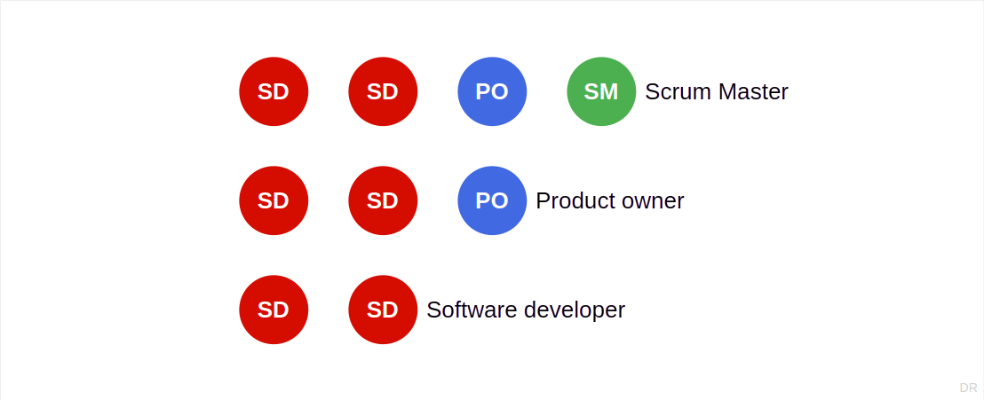
Team Structure

Slide 4
First Meeting
Check participation
No-shows (without explanation) will be removed

Slide 5
Team Issues
Your team’s success
Steady participation wins the course
Team size does not matter
Credit points (ECTS) determine time spent

Slide 6
Thank you! Any questions?
dirk.riehle@fau.de – https://oss.cs.fau.de
dirk@riehle.org – https://dirkriehle.com – @dirkriehle

Slide 7
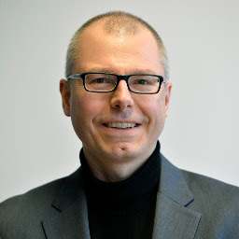
Thank You! Any Questions?
Prof. Dr. Dirk Riehle, M.B.A.
dirk.riehle@fau.de, https://oss.cs.fau.de
dirk.riehle@bayave.com, https://bayave.com
dirk@riehle.org, https://dirkriehle.com
Twitter: @dirkriehle

Slide 8
Legal Notices
License
Licensed under the CC BY 4.0 International license
Copyright
© Copyright 2022 Dirk Riehle, some rights reserved

